Slide 1







PRESENTATION
INSURANCE ANALYTICS
Strategic Data Insights & Business Intelligence Solutions
Data-Driven Insights
Business Intelligence
Performance Analytics

Slide 2


Presented by
Group 6
MATURU PAVAN KUMAR
Mamidala Charan
Shahil Farshad
Member
Member
Member
Kale Vaibhav Dadasheb
Madhushri Veeranna Malagar
Pankaj Bhaskar Patil
Member
Member
Member

Slide 3










Table of Contents
Introduction
Objectives of the Study
KPIs List (Part 1 & 2)
Tools
Excel Dashboard
Power BI Dashboard
Tableau Dashboard
MySQL Queries
Key Insights
Thank You

Slide 4







Introduction
Key Business Drivers
Uncovering meaningful business insights from insurance data by analyzing policy performance, customer behavior, and claims patterns
Revenue Growth
Customer Segmentation
Transforming raw and fragmented data into actionable insights
Policy Adoption Trends
Claims Impact

Slide 5






Objectives of the Study
1
Identify trends and patterns in policy sales, customer demographics, and claims behavior
2
Analyze branch-level and individual performance to uncover top performers and areas needing improvement
3
Evaluate business growth through metrics such as premium growth, conversion rates, and retention trends
4
Detect inefficiencies and bottlenecks in the sales funnel and opportunity pipeline
5
Provide insights into customer segmentation for targeted marketing and engagement strategies
6
Support proactive decision-making by highlighting risks, opportunities, and future business potential

Slide 6

KPIs List - Part 1
1
Total Revenue
2
Total Meetings
3
Total Policy
4
Active Policies
5
Inactive Policies
6
Profit
7
Claim Ratio (%)
8
Stage Funnel by Revenue
9
Claim Ratio by Account Executive
10
Revenue Collected by Executives

Slide 7
KPIs List - Part 2
11
Policy Portfolio Distribution (New / Cross Sell / Renewal)
12
Sales Breakdown by Income Type
13
Policy Type vs Policy Count
14
Policy by Type (Engineering, Fire, Liability, Marine, etc.)
15
Revenue by Month
16
Client Connection Pulse (Meeting Count by Executive)
17
Yearly Meeting Count
18
Number of Policies by Executive
19
Policy by Status (Active vs Inactive)
20
Top Open Opportunities

Slide 8

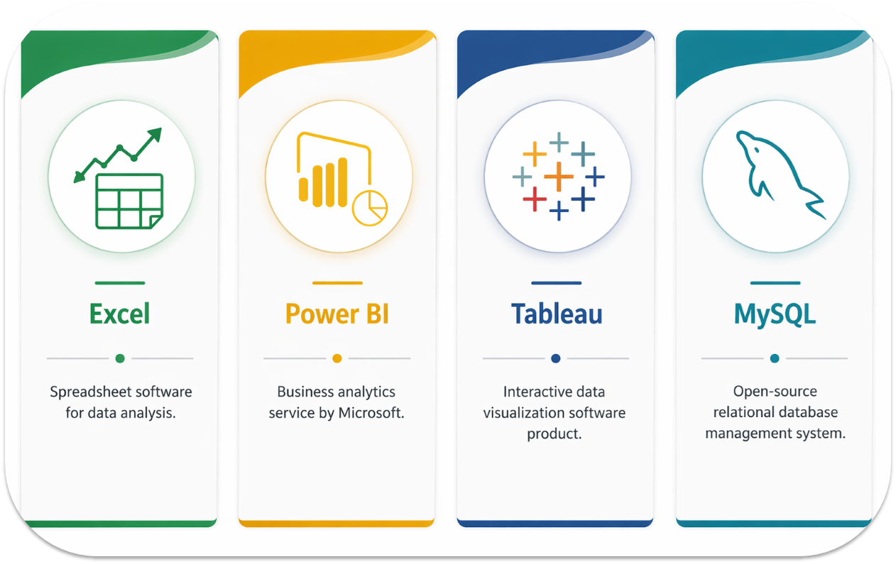
Tools

Slide 9
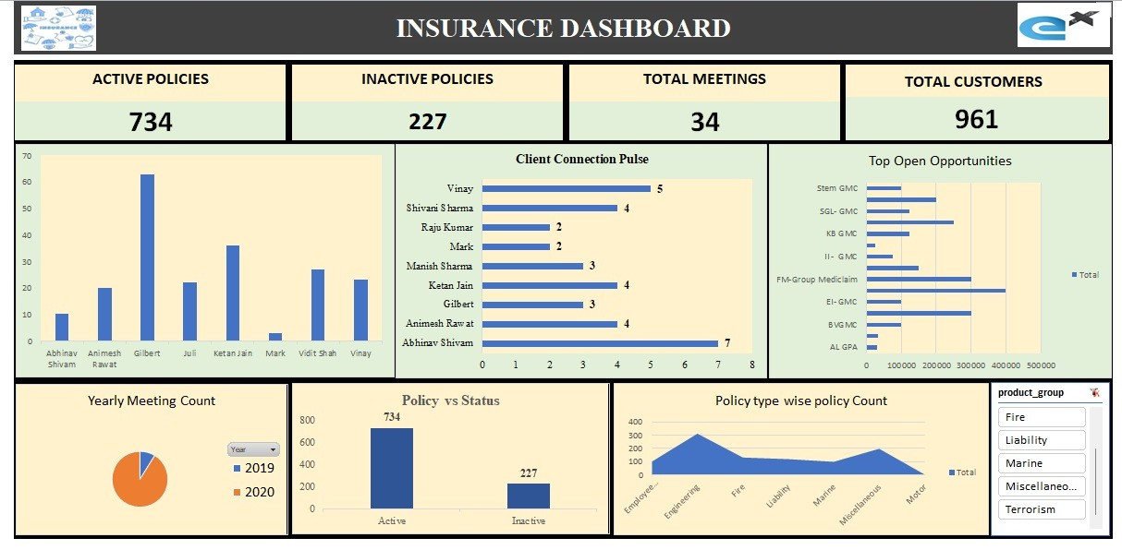
Excel Dashboard

Slide 10
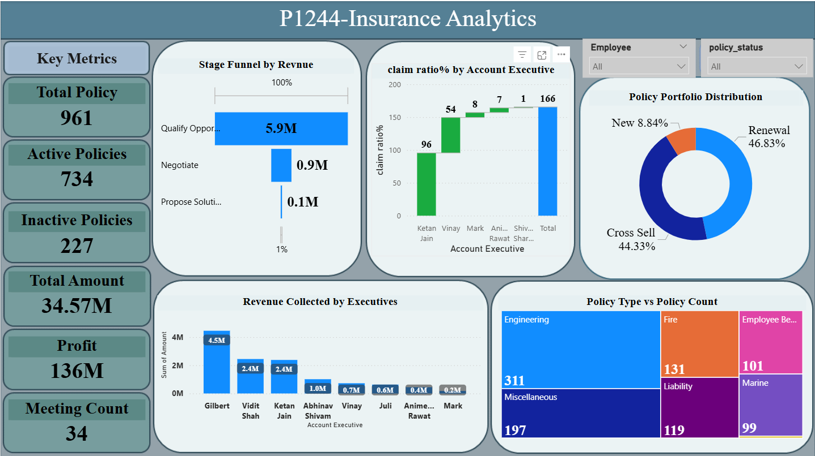
Power BI Dashboard

Slide 11

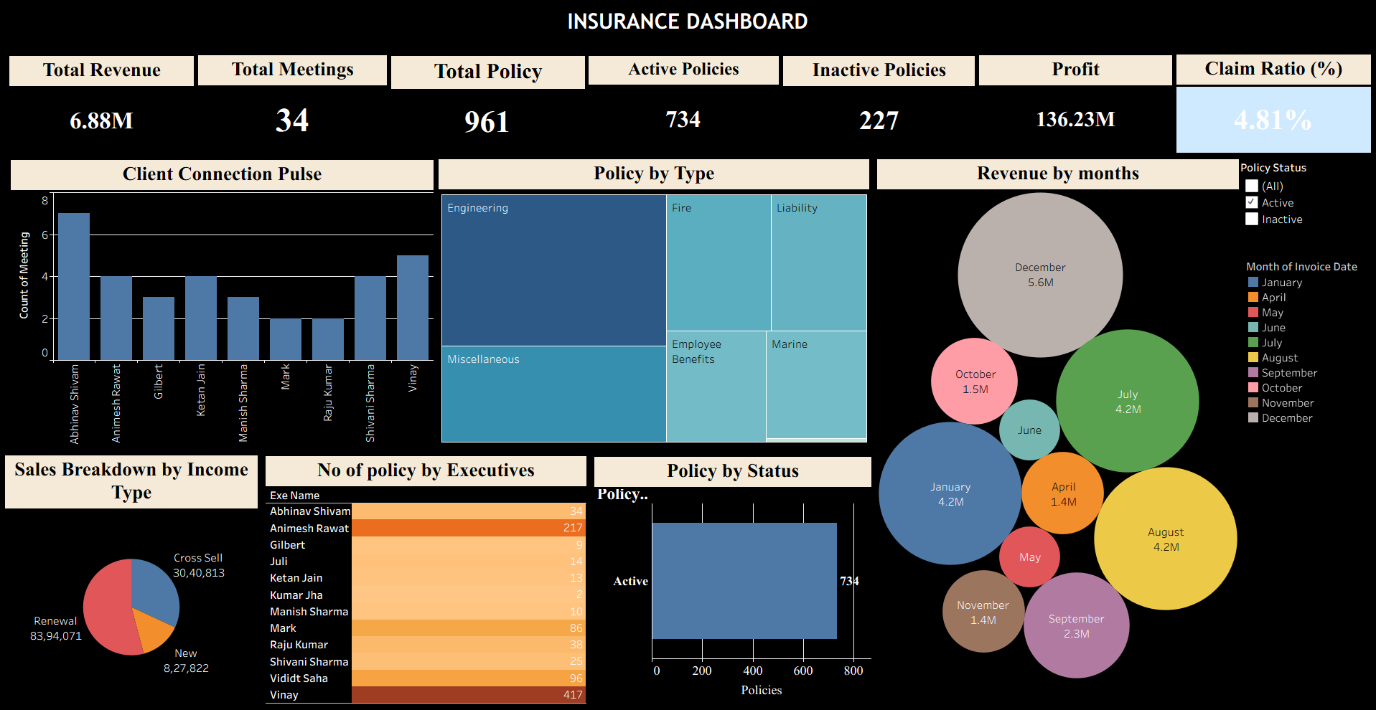
Tableau Dashboard

Slide 12

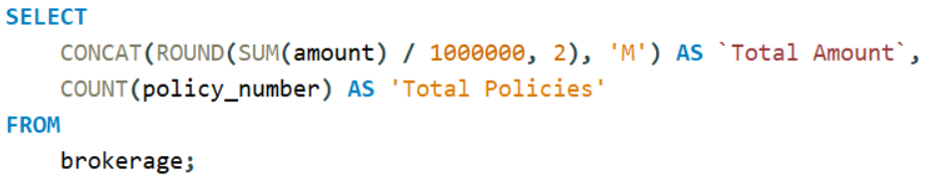
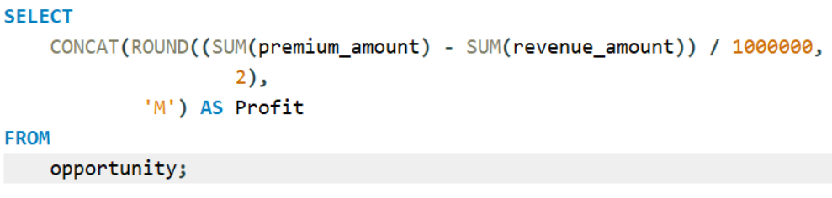
MySQL Queries
Total Brokerage Amount
Profit

Slide 13
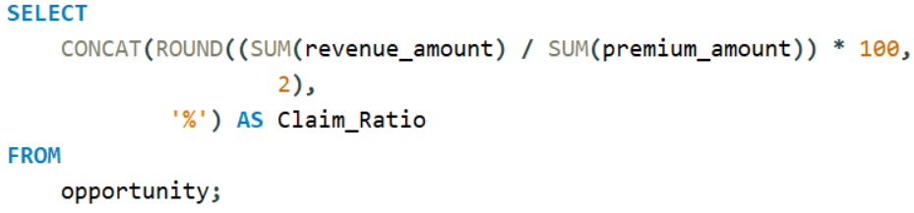
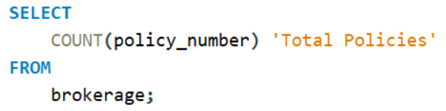
MySQL Queries
Claim Ratio %
Total Policies

Slide 14
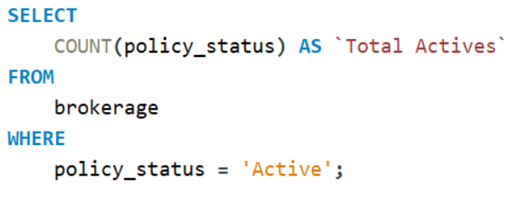
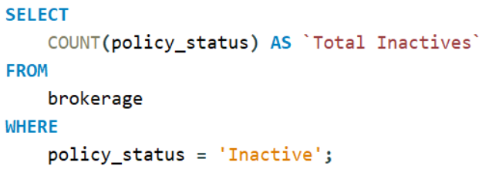
MySQL Queries
Total Active Policies
Total Inactive Policies

Slide 15
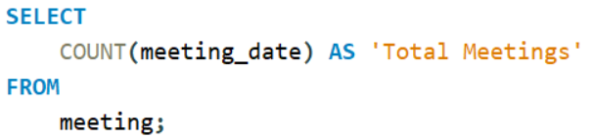
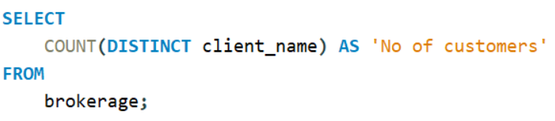
MySQL Queries
Total Meetings
Total Customers

Slide 16
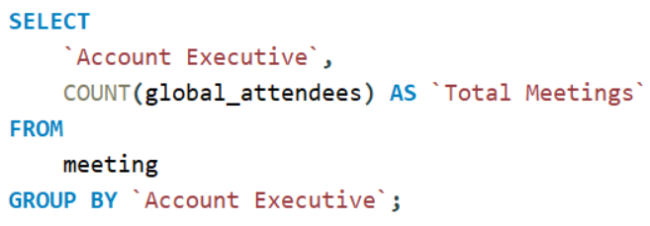
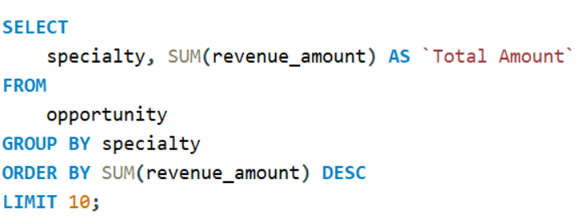
MySQL Queries
Total Meetings by executives
Top 10 Opportunities

Slide 17
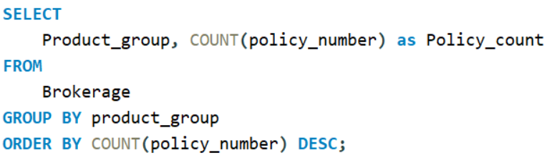
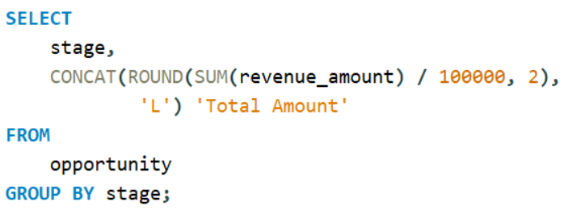
MySQL Queries
Policy Group by Policy Count
Stage Wise revenue

Slide 18
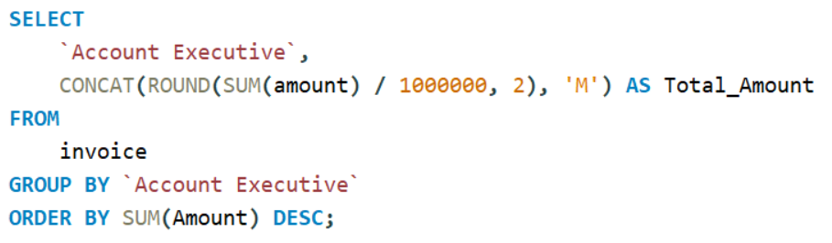
MySQL Queries
Revenue Collection by executive

Slide 19
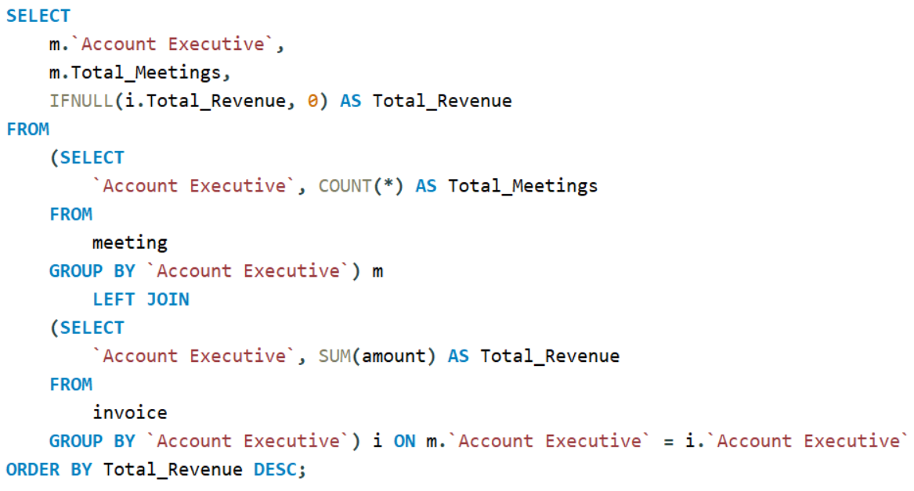
MySQL Queries
Total Meeting by Revenue by Executive

Slide 20

Key Insights
1
Business Performance
2
Policy Portfolio
Strong revenue (~6.8M) with high profit (~136M)
734 active out of 961 policies; 227 inactive (~23% renewal gap)
Low claim ratio (~4.81%) indicates effective risk management
Renewals (46.8%) & Cross-sell (44.3%) dominate; low new business (~8.8%)
3
Sales & Funnel
4
Employee Performance
Major drop: Qualification (5.9M) → Negotiation (0.9M) → Proposal (0.1M)
Revenue contribution is skewed; top performer ~4.5M
Significant conversion leakage indicates inefficiencies in closing deals
Performance gaps and training needs identified; varying claim ratios

Slide 21
Key Insights
5
Customer Engagement
6
Product & Policy
Total meetings (34) are low compared to revenue
Engineering and Miscellaneous policies dominate in policy count
Uneven client interaction across executives indicates inconsistent outreach
Marine and Employee Benefits have lower adoption with untapped growth potential
7
Revenue Trends
8
Opportunity Insights
Highly seasonal: Peaks in December (~5.6M) and July & August (~4.2M each)
High-value open opportunities suggest future revenue potential
Low performance months (April, May, June) indicate off-season dips or missed opportunities
Focus on top deals could significantly boost revenue if closed effectively

Slide 22







Thank You
For Your Attention
Insurance Analytics
Data-Driven Insights
Strategic Intelligence

